Slide 1

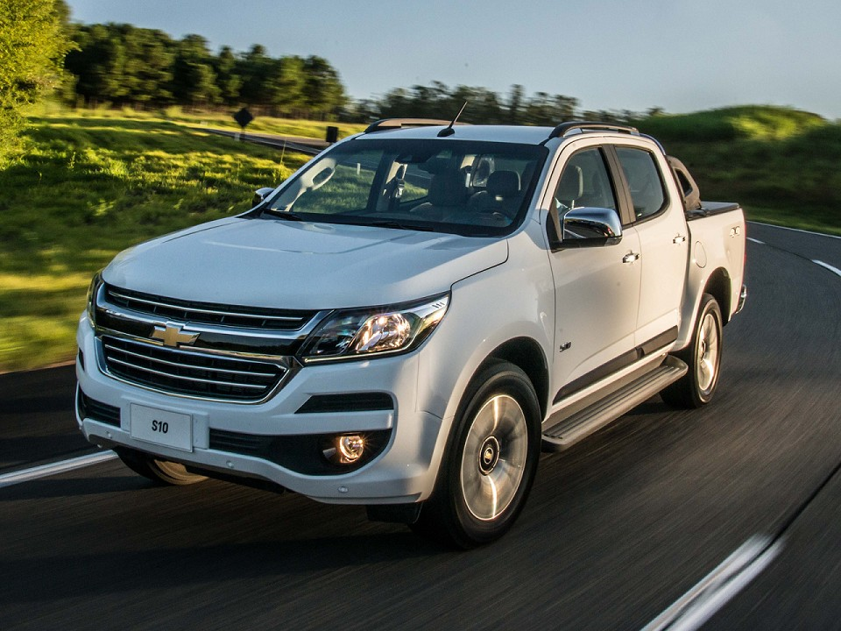






TOWER’S
MULTIMARCAS

